Slide 1
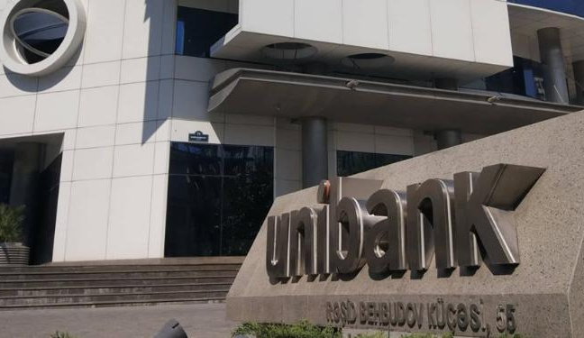
Telecom
Partnership

Slide 2

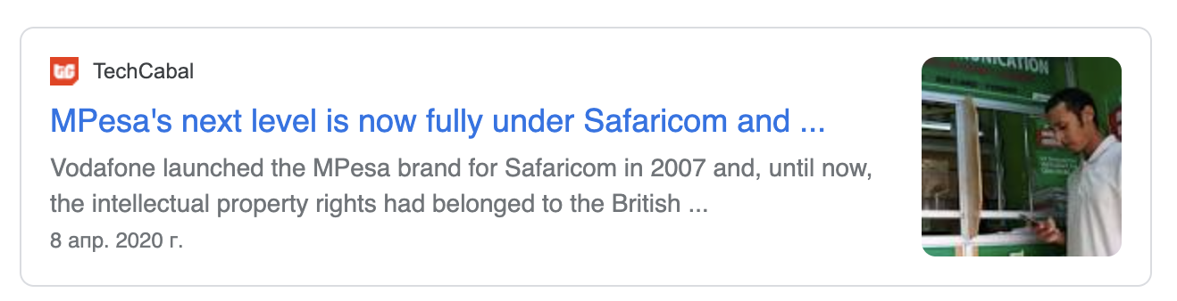
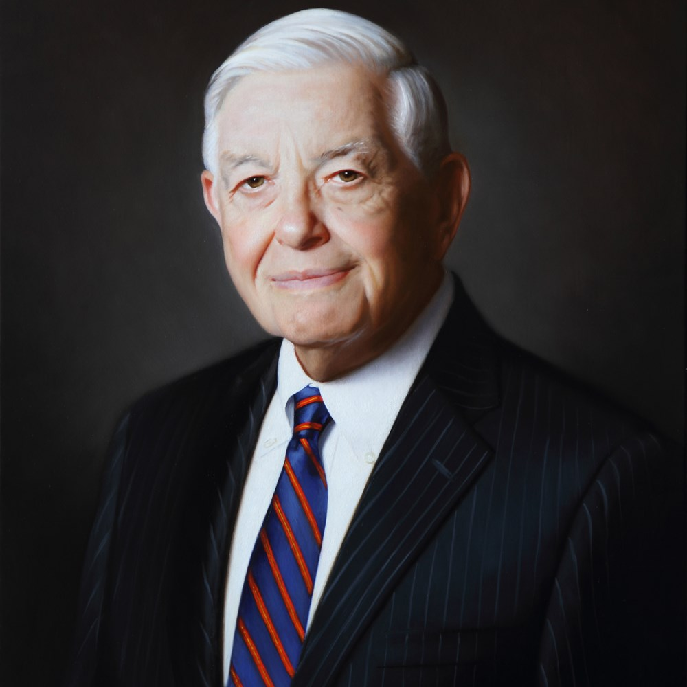
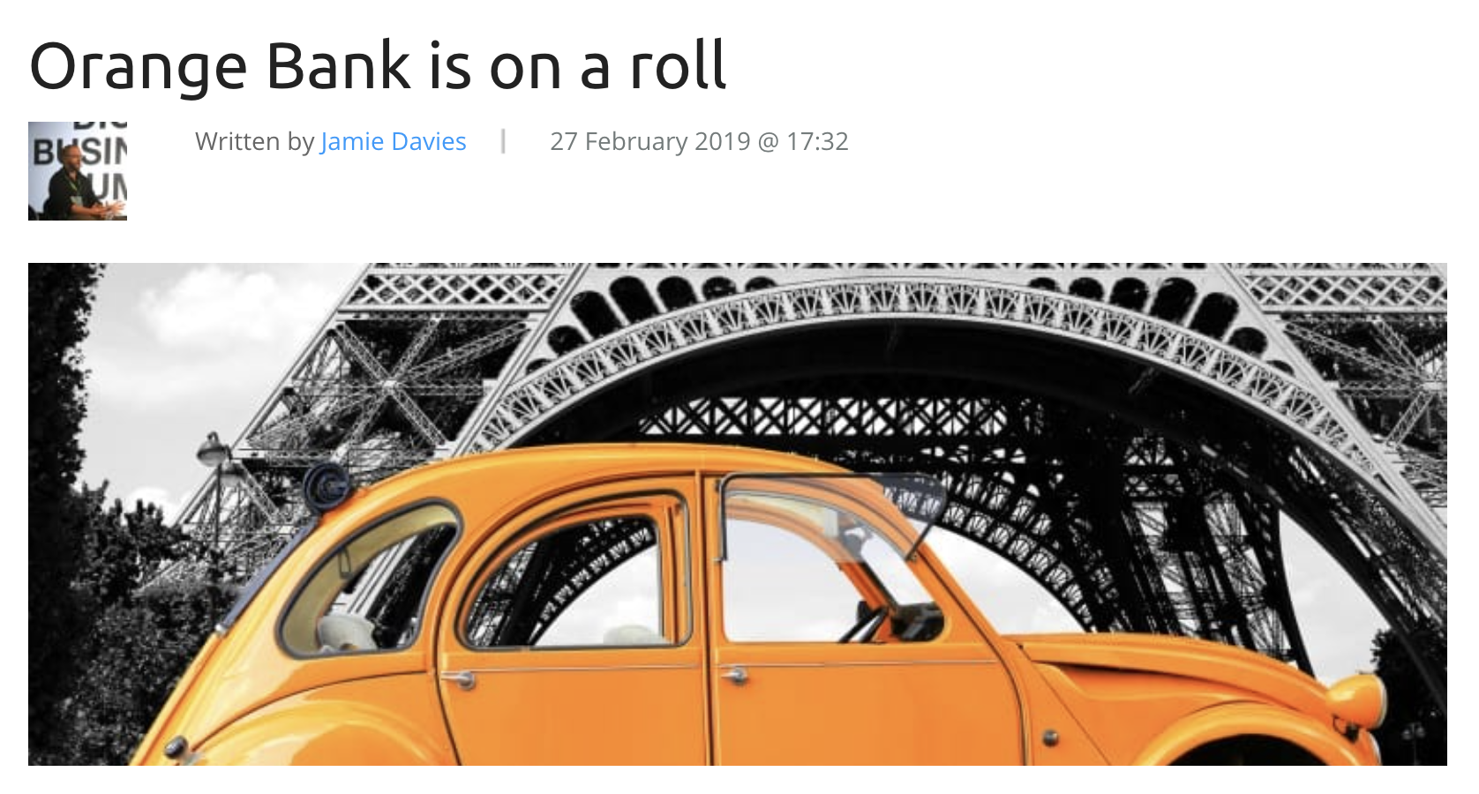

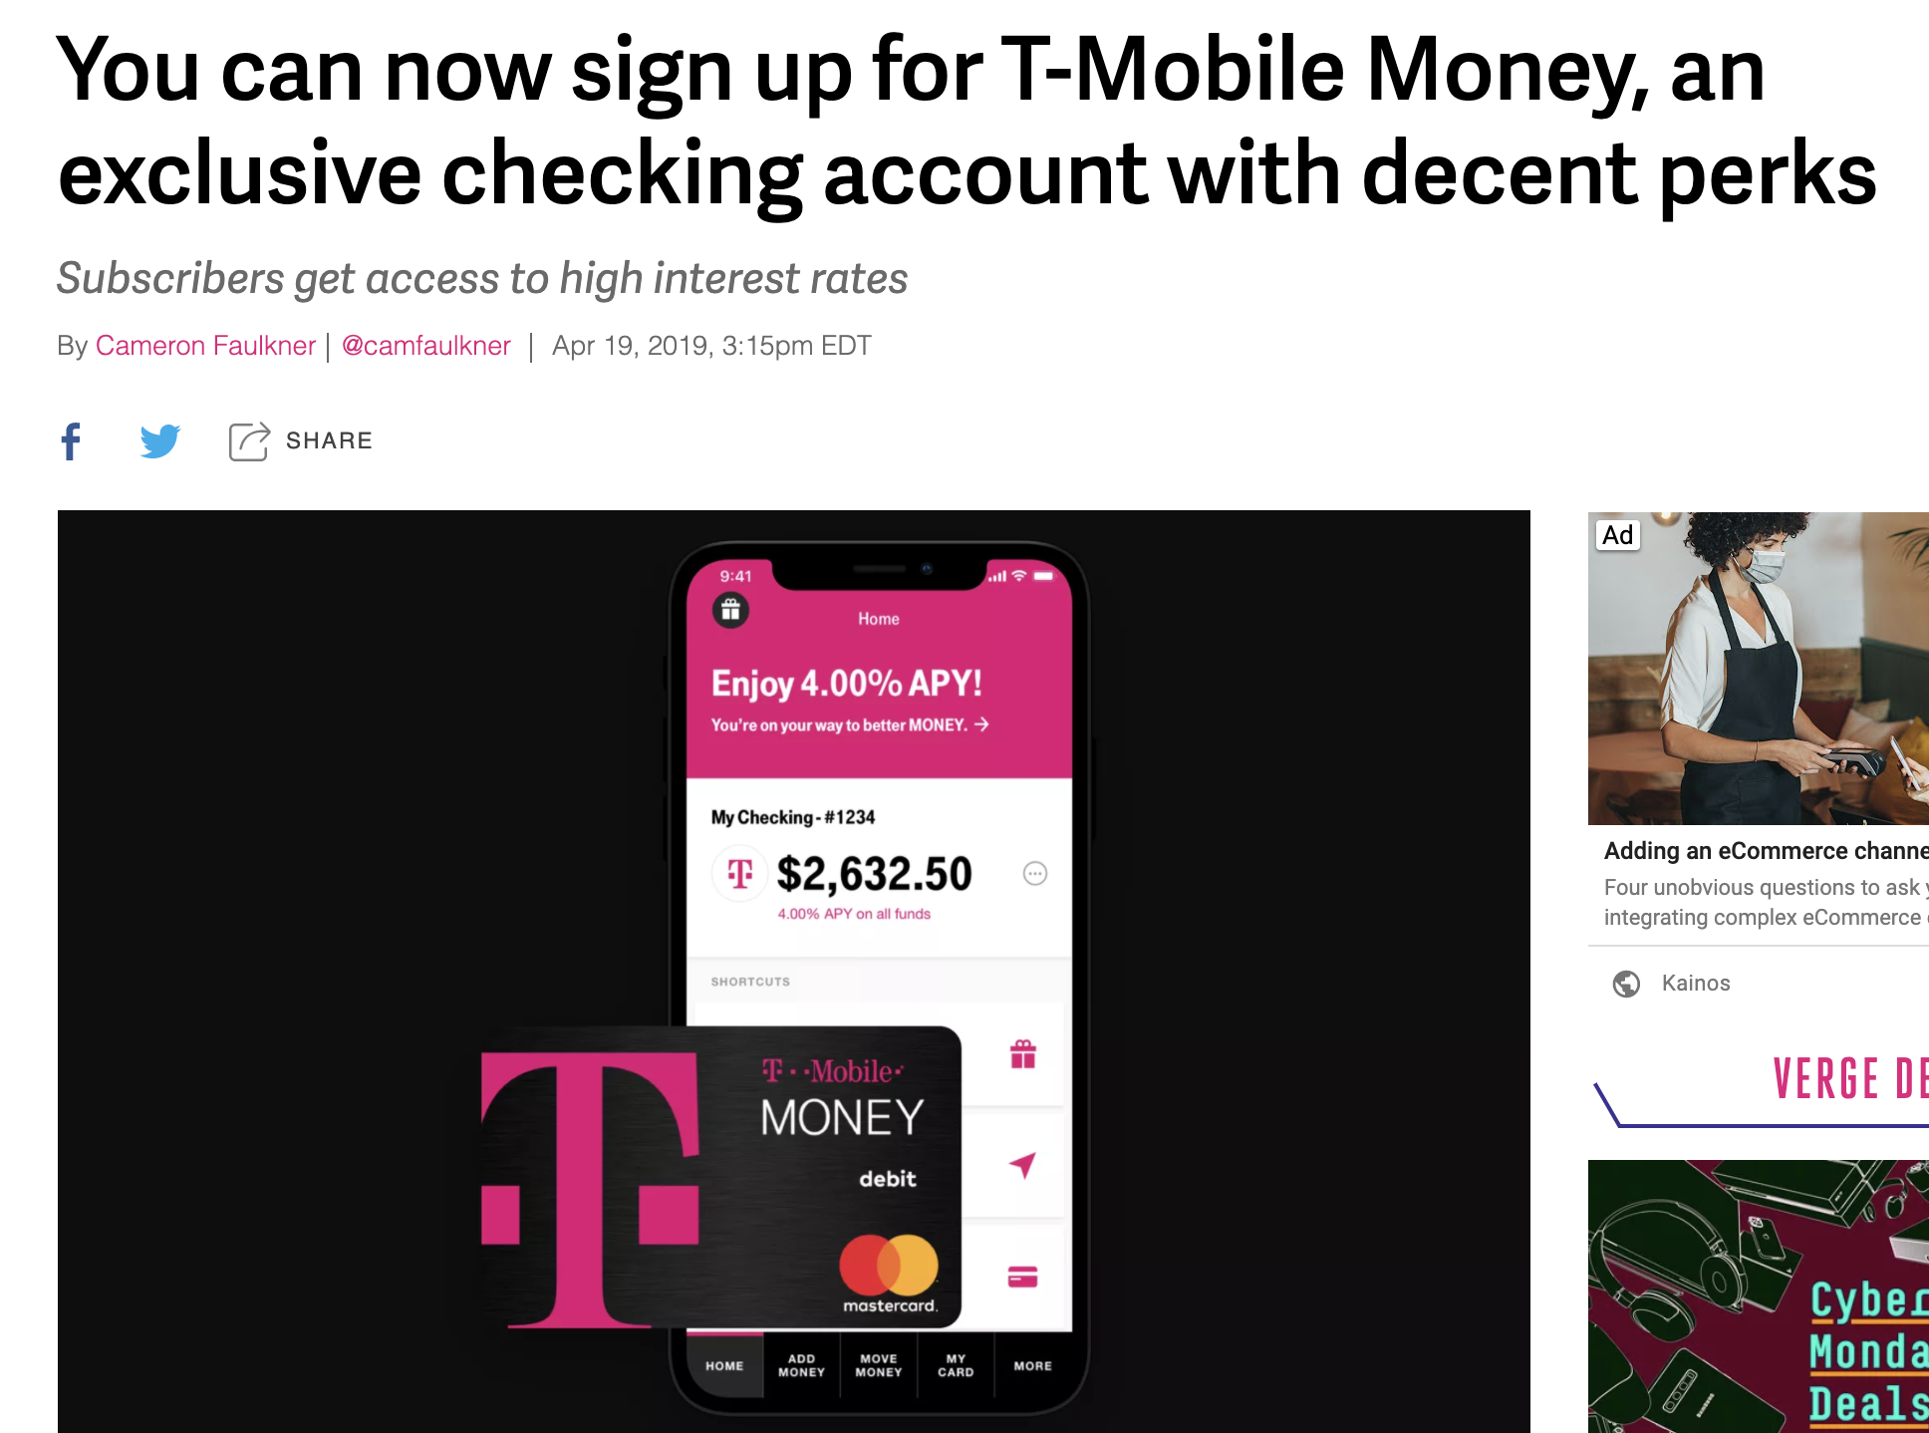
Context
Hugh McColl
Former Chairman, CEO Bank of America
In a 1995 speech, Hugh McColl, Jr. said, “As every school child knows, the dinosaur didn’t survive the Ice Age…. It’s not that he lacked the capacity to evolve. He just didn’t have the time. Unlike the dinosaur, bankers can see the changes ahead. We have a choice in the matter. The dinosaur never did.”

Slide 3
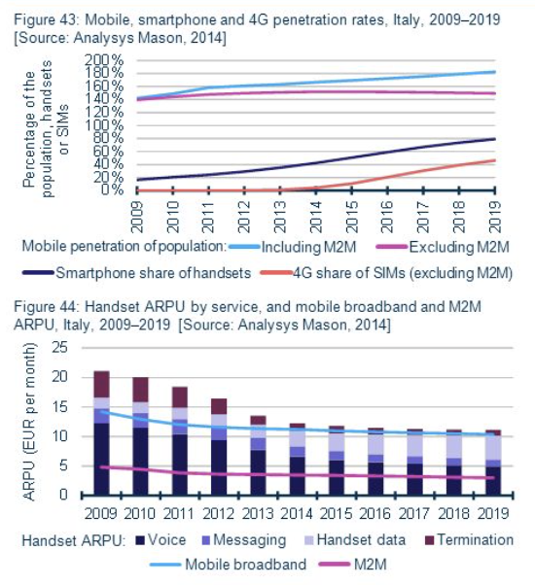
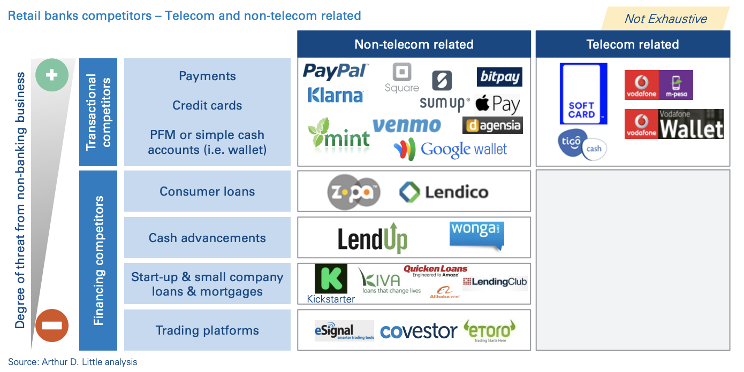
Problems on todays the periphery is our problem tomorrow
A
Telecoms struggling with declining revenues on voice and ARPU, even if data revenue is growing (however due to economics of scale – lower cost price per unit – telecoms adjusting prices on data)
Telecoms capital cost them too much: too much to earn more tomorrow than today, and too much to be profitable in the future in they not differentiate
There is only one way for telecoms not to die like dinosaurs – start to be convergent and they have already started:
Transform from telecom to FinTech
Strategic Partnership with Banks
Partnership with FinTech
Going to OTT market
B
C

Slide 4
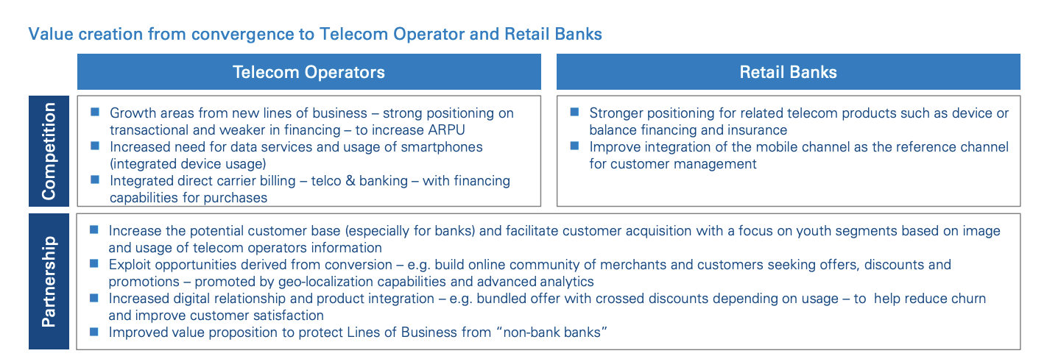



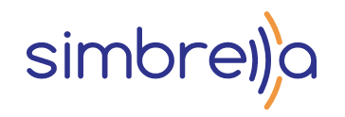
Opportunity Bank and Telecoms should be as one to surge
A
B
A
C
C
A
Azercell builds Strategic Partnership with International Bank of Azerbaijan in convergent products and Data related initiatives (46% market share)
D
Simbrella partners with all three operators in SimKredit and other products
D
B
Bakcell and Nar are the part of the NEQSOL holding which try to build ecosystem (52% market share)
C

Slide 5
Simbrella
NUMBERS
220 Million
END USERS SERVED GLOBALLY
20 Years
OF PROFESSIONAL EXPERIENCE
3.1 Billion$
WORTH OF TOTAL LOANS DISBURSED TO DATE
30 Million
TRANSACTIONS PER DAY
25 Countries
OUR GLOBAL PRESENCE
10.2 Billion
TOTAL LOANS PROVIDED TO DATE
EXPERTISE
Convergent product development
Data Modeling and Analysis
Existing of real big data of customer behavior in Azerbaijan market
PRODUCTS
FinTECH
MICRO LOANS
TRANSACTION COMPLETION
DATA
DATA VALIDATION AND ENRICHMENT
Data Analytics as SERVICE

